Slide 1

Argonaut Questionnaire HL7 FHIR Connectathon
Saturday, September 29 / 9:00 am – 10:00 pm Sunday, September 30 / 9:00 am – 5:00 pm

Slide 2
Connectathon Overview
FHIR Connectathon Objectives
Track Selection
Timeline of Activities
Participant Opportunities
Location of Support Materials
How to get your questions answered

Slide 3
What’s to be gained by attending a FHIR Connectathon?
Join a community of FHIR users
Develop and test your system and use of the standard
Demonstrate what’s possible
Refine the FHIR Specification

Slide 4
Track Selection
Review track details to find your focus
Select your track in the Pre-Connectathon Survey
Connect with your track lead in advance
We recommend participating fully in only one track

Slide 5
Timeline of Activities
One Month Prior: Registration
1-3 weeks prior: Track Orientation Meeting
On-Site
Saturday, September 29 / 9:00 am – 10:00 pm
Working Sessions
Breakouts: Orientations on FHIR and Test Tools
Sunday, September 30 / 9:00 am – 5:00 pm
Q1-Q2 Working, Q3 Testing, Q4 Wrap Up

Slide 6
Participant Opportunities
Join in the community
Bring Questions and share your challenges
Help others by sharing your knowledge
Bring your development system ready to go
Have your application installed
Have you environment configured
Raise questions that identify hot topics
Record your Results
What happens at Connectathon stays at Connectathon.
It’s OK to fail.

Slide 7
Location of Support Materials
FHIR Specifications:
R3 final: http://hl7.org/fhir/STU3/index.html
Track Definition
http://wiki.hl7.org/index.php?title=201801_Argonaut_Questionnaire
Tracking Spreadsheet : https://docs.google.com/spreadsheets/d/1We7Rlw61YNG9qSmUq0UIE6yHUb_1v-08J15iFSzEGaU/edit?usp=sharing ( note that this may change )
Issues will be posted and managed on GitHub Issues
Offline discussions on Zulip

Slide 8
How to Get your Questions Answered
FHIR Chat:
https://chat.fhir.org/#narrow/stream/connectathon.20mgmt/subject/C17.20Versioned.20API
On Site Issues: Sandy Vance (sandra.vance@aegis.net)
Contact me: Eric Haas(ehaas@healthedatainc.com)

Slide 9
Intro to the Argonaut Questionnaire Track
Introduction to Track Lead
Track Definition
List of participating systems in the track (& contacts?)
References to the servers & clients for the track
Goals for this track

Slide 10
Track Lead
Track Lead: Eric Haas(ehaas@healthedatainc.com)
Argonaut Project FHIR SME
Consultant
Pet Doctor!

Slide 11
Track Definition
The Argonaut Questionnaire Project has drafted the
Argonaut Questionnaire Implementation Guide to provide guidance and FHIR RESTful APIs to support interchange of:
Simple forms based on FHIR Version
Adaptive Questionnaires(1) such as PROMIS forms
This Track is designed to test and pilot the Guide and see what works and what doesn’t and what is missing.

Slide 12
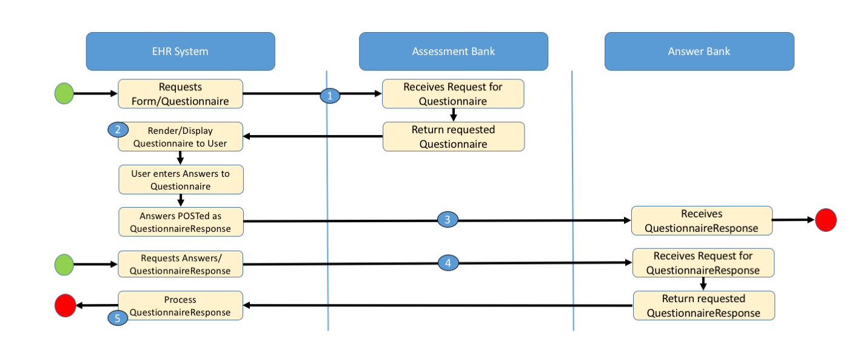
Track Definition
The Static Forms scenario is focused on this basic workflow (Read the Argonaut Questionnaire Track description on the wiki and the Argonaut Questionnaire Implementation Guide to familiarize yourself with the scenarios and concepts)

Slide 13
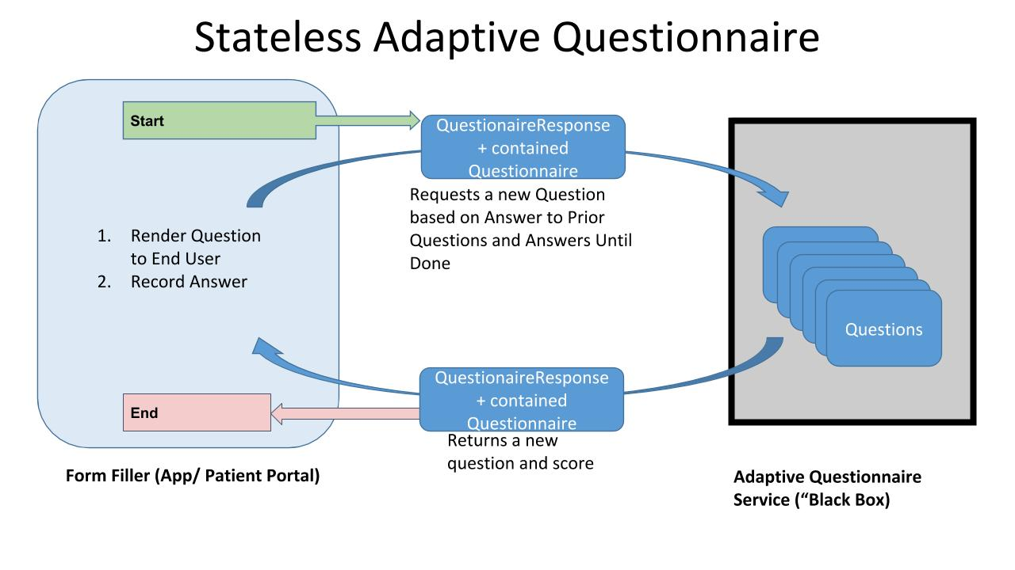
Track Definition
The Adaptive Forms scenario is focused on this basic workflow (Read the Argonaut Questionnaire Track description on the wiki and the Argonaut Questionnaire Implementation Guide to familiarize yourself with the scenarios and concepts)

Slide 14
Track Definition
Note that we will be working next to the Structured Data Capture Track which is focused on more sophisticated questionnaires and topics such as form “pre-population”. We expect there to be lots of opportunities to interact with them and share data.

Slide 15
Participating Systems
In the Argonaut Questionnaire we have broad industry support including active participation from:
Meditech
Epic
All Scripts
Partners
PROMIS
And others
Your participation in the connectathon is welcome and If you or your company are interested in participating in the connectathon, please do the following.
Register to attend the WGM, and make sure to select the Connectathon option when you do
Complete the HL7 FHIR Pre-Connectathon Survey (Link available SOON!) for each member of your team to indicate their primary track.

Slide 16
Registration for This Track
Besides registering for the Connectathon we would like you to know what roles you are bringing to the table and how to connect:
Roles for this track are:
Adaptive Questionnaire Service:
“Assessment-Bank
(Optionally) “Answer-Bank“(2):
Form-filler:
Provider EHR(3
Share your contact information and endpoints on google sheets here ( or instruction how to connect )
https://docs.google.com/spreadsheets/d/1We7Rlw61YNG9qSmUq0UIE6yHUb_1v-08J15iFSzEGaU/edit?usp=sharing

Slide 17
Client and Server References
To get started there are
Questionnaire Examples (see the track wiki for their FHIR endpoints)
QuestionnaireResponse Examples
PostMan Collection
Test Implementation
Simulates the Adaptive Questionnaire transactions

Slide 18
Track Goals
The goal of the Argonaut Questionnaire Project is to develop guidance to support interchange of:
Simple forms
Adaptive Questionnaires
using the FHIR RESTful API.
The goal for this Connectathon is PILOT the guidance and API documentation that the project has drafted.
Identify what works and what doesn’t before publishing the Implementation Guide.

Slide 19
Question?

